Slide 1
INTOSAI WORKING GROUP ON KEY NATIONAL INDICATORS
WORKING GROUP ACTIVITY REPORT (2014 – 2015)
Ms. Tatiana Manuylova
Auditor of the Accounts Chamber of the Russian Federation
Sofia, March 25, 2015

Slide 2
INTOSAI WORKING GROUP ON KEY NATIONAL INDICATORS
WORKING GROUP ACTIVITY REPORT
7th MEETING OF THE INTOSAI WG ON KNI IN CUTA (INDONESIA), FEBRUARY 2014
New annexes to the White Paper on Key National Indicators
Principles for the development and use of the key national indicators
Analysis of opportunities on the use of KNI for international comparisons in the context of sustainable development and recommendations (SAI of Hungary)
SAI’s role in development and use of key national indicators for R&D development (SAI of Finland)

Slide 3
INTOSAI WORKING GROUP ON KEY NATIONAL INDICATORS
WORKING GROUP ACTIVITY REPORT
DEVELOPING THE INTOSAI STANDARD ON THE BASIS OF THE WHITE PAPER ON KNI
Project proposal of the Standard on the development and use of KNIs developed (May 2014)
Proposal to prepare a Guidance document prier to the Standard development (October 2014)
Presentation and approval of the Project proposal at the 6th KSC Steering Committee Meeting (October 2014)

Slide 4
INTOSAI WORKING GROUP ON KEY NATIONAL INDICATORS
WORKING GROUP ACTIVITY REPORT
REPORTS ON THE INTOSAI WORKING GROUP ON KNI ACTIVITY
6th INTOSAI KSC Steering Committee Meeting
(October 2014, Cairo)
66th INTOSAI Governing Board Meeting
(November 2014, Vienna)

Slide 5
THE WORKING GROUP ACTIVITY REPORT
INTOSAI WORKING GROUP ON KNI SUBPROJECTS REALIZATION
Analysis of opportunities on the use of KNI for international comparisons in the context of sustainable development and recommendations (SAI of Hungary)

Slide 6
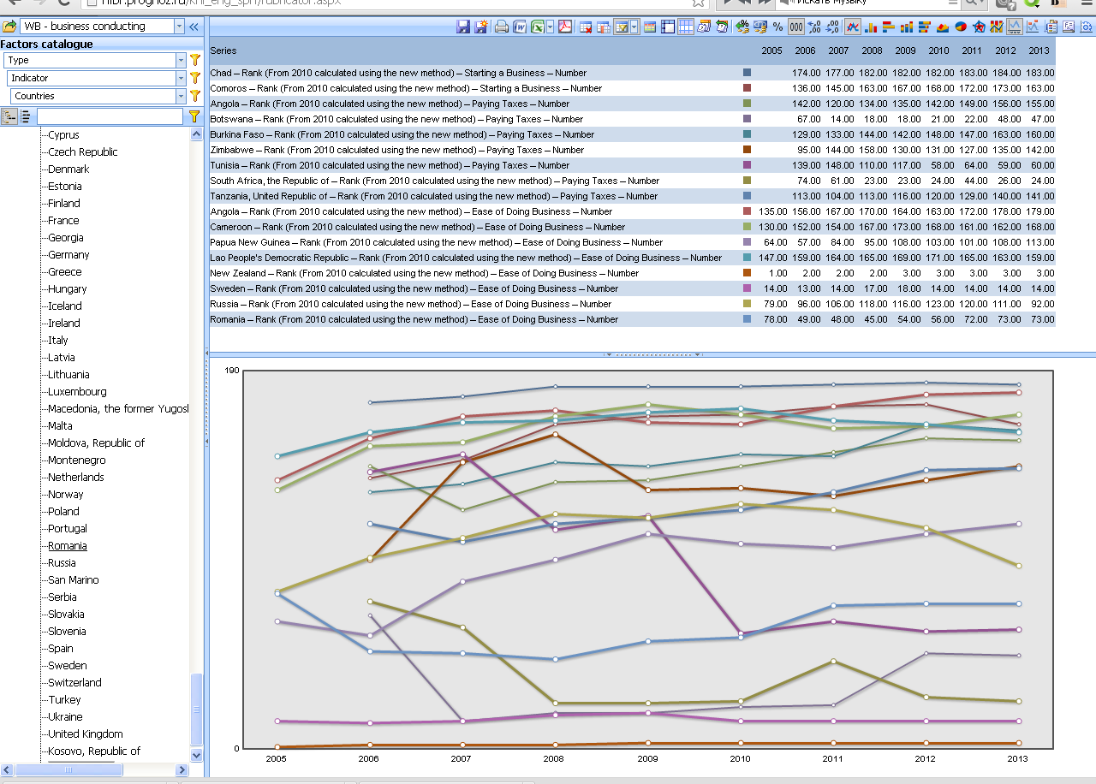
INTOSAI WORKING GROUP ON KEY NATIONAL INDICATORS
THE WORKING GROUP ACTIVITY REPORT
KNOWLEDGE BASE ON KNI
current version
of the Knowledge Base 2014
new version
of the Knowledge Base 2015
Glossary
Countries
Analytical materials and other sources
Videoconferences
Discussions
Surveys

Slide 7
INTOSAI WORKING GROUP ON KEY NATIONAL INDICATORS
INITIATIVE TO RESEARCH COUNTRIES PREPAREDNESS TO USE THE KNI SYSTEMS IN SAI ACTIVITIES
WORKING GROUP MEMBER-STATES - 23

Slide 8
INTOSAI WORKING GROUP ON KEY NATIONAL INDICATORS
WORKING GROUP ACTIVITY REPORT
CHANGES IN THE LEGISLATION IN THE RUSSIAN FEDERATION RELATED TO KNI
A new Federal Law on the Strategic Planning in the Russian Federation was adopted in 2014
According to the Law the Government is responsible for development of the system of strategic planning documents which include policy targets and indicators used to measure their attainment
The set up of indicators system will be a starting point in getting accurate information about the implementation of strategic plans and policy targets attainment. It may also be a basis for the future development of KNI system
The functions of the Accounts Chamber of the Russian Federation include monitoring and analyzing the development and use of the indicators system used to outline policy priorities and targets

Slide 9
INTOSAI WORKING GROUP ON KEY NATIONAL INDICATORS
WORKING GROUP ACTIVITY REPORT
7th MEETING OF THE EXPERT GROUP ON KNI OF THE CIS MEMBER-STATES
(YEREVAN, ARMENIA, MAY 2014)
Member-states joined the initiative to research countries preparedness to use the KNI systems in SAI activities and provided the Secretariat with the information in response to the questionnaire
translation of the Annexes C, D,E of the White paper on KNI into Russian language

Slide 10
INTOSAI WORKING GROUP ON KEY NATIONAL INDICATORS
WORKING GROUP ACTIVITY REPORT
COOPERATION WITH INTOSAI COMMITTEES AND DEPARTMENTS
2nd EUROSAI-ASOSAI joined conference (Moscow, September 2014)
47th ASOSAI Governing Board Meeting (Moscow, September 2014)

Slide 11
INTOSAI WORKING GROUP ON KEY NATIONAL INDICATORS
WORKING GROUP ACTIVITY REPORT
NEW FRAMEWORK AGREEMENT BETWEEN INTOSAI AND OECD
Informing the INTOSAI General Secretariat on the meeting between the WG Secretariat and OECD in 2014
Preparing a draft framework agreement between INTOSAI and OECD and agreeing it with the WG member-states

Slide 12
INTOSAI WORKING GROUP ON KEY NATIONAL INDICATORS
WORKING GROUP ACTIVITY REPORT
MAIN ACTIVITIES OF THE INTOSAI WORKING GROUP ON KNI IN 2015
Elaborating a Draft Guidance document on the development and use of KNI’s in SAI’s activities
Overhauling the Knowledge base on KNI
Preparing a draft framework agreement between INTOSAI and OECD and agreeing it with the WG member-states

Slide 13
INTOSAI WORKING GROUP ON KEY NATIONAL INDICATORS
WORKING GROUP ACTIVITY REPORT
THANK YOU!

